Slide 1
THE question
How can ML models improve short term wildfire prediction in California?
Why this matters
Supports Early Warning
Planning for Resource Allocation
Scalability & Expansion
Improves Policy Decisions
Notes:
We started with our question…
This is important work because:
It supports early warning systems and evacuation planning, helping people respond before disaster strikes
It enables early allocation of resources, like fire fighting equip and water to reduce damage and fatalities
It offers scalability, allowing similar models to be applied in other fire-prone regions
gives policymakers evidence to plan ahead and direct funding more effectively.
—-------------------------------------------------------------------------
Traditional wildfire prediction relied on weather forecasts, vegetation dryness, and static risk maps, which lacked precision for short-term action.
More recently, machine learning has been used to predict fire risk using historical weather and ignition data.
The field is now moving toward AI systems that integrate spatial, visual, and temporal data for more dynamic, location-specific forecasts.
Our project builds on this by using machine learning to predict wildfires over 3, 7, and 14-day windows, usingdata that captures temporal patterns, geographic location, and weather conditions.

Slide 2
Existing wildfire ml models
Item | Paper | Model | Features | Prediction
Data-Driven Wildfire Risk Prediction in Northern California (atmosphere 2021) | Atmosphere 2021 | Random Forest - 92%, Adabost - 91.5%, Gradient Boosting Trees - 90.5% | Weather, Terrain, Powerline and Vegetation | Fire / No Fire
Identifying Key Drivers of Wildfires in the contiguous US using Machine Learning and Gaming Theory (Earth’s Future, May 2021) | Earth’s Future, May 2021 | eXtreme Gradient Boosting Model - RMSE 2.04 km squared | Local Meteorology, Large Scale Meteorological Patterns, Land Surface Properties and Socio-Economic | Size of Burnt Area
Wildfire Prediction Through Live Fuel Moisture Content Maps (Civil and Environmental Engineering, Stanford University) | Civil and Environmental Engineering, Stanford University | SVM - 65.86%, Random Forest - 71.95%, CNN - 52.46% | Live Fuel Moisture Content (LFMC) Maps | Fire / No Fire
Reference: Ritter, J., Young, M., & Krishnan, P. (2022, August 4). California wildfires prediction [Final presentation]. W207 Final Project. [https://corneliailin.github.io/datasci_w207_spring2025/summer2022_projects/Prakash_Krishnan_Final_Presentation_CA_Wildfires_Aug_4_2022.pdf]
Notes:
Fire prediction is an active area of research. Here are a few examples of others exploring models using fuel moisture, risk data, and game theory.

Slide 3
APPROACH
Build Baseline
Develop Research
Question
Data
Selection
EDA
Pre-processing
Model Selection
EDA
Data Merges
Location
Data
Selection
Build Baseline
Pre-processing(inc. Temporal Split)
Feature
Engineering
Experimentation
& Measurement
Conclusion
Notes:
This slide outlines our general approach. I want to highlight two things:
We merged multiple datasets to combine weather and climate region (location) data. (which Carlos will talk about this more)
The 60/20/20 split we did was time based, which was necessary for maintaining the integrity of our time-based predictions.
now, I will turn it over to Carlos..

Slide 4
The DATA
Original Data
California Weather & Fire Prediction:
https://zenodo.org/records/14712845
Size: 14,988 rows, 14 columns
Timeframe: 01-01-1984 to 01-12-2025
Geolocated Data
Cal Historical Fire: All & 2024/2025
https://www.fire.ca.gov/our-impact/statistics
NASA POWER : Localized averaged weather data
https://power.larc.nasa.gov/data-access-viewer/
USA Counties Shapefile:
https://www2.census.gov/geo/tiger/TIGER2024/COUNTY/tl_2024_us_county.zip
USA CONUS Climate Divisions Shapefile
https://www.ncei.noaa.gov/access/monitoring/reference-maps/conus-climate-divisions
Final Size of Merged Data: 20,710 rows, 108 columns
Timeframe: 01-01-1984 to 01-12-2025
INDEX:
DATE
LABELS:
CONUS CODE
NUMERICAL:
Precipitation
Min/Max Temp
(Daily) Temp Range
Avg Wind Speed
Wind Temp. Ratio
Lagged Precip.
Lagged Avg Wind Speed
Lagged Temp
TARGET VARIABLES:
Fire in 3 Days
Fire in 7 Days
Fire in 14 Days
Notes:
Slide 5 provides an overview of how we constructed and enhanced our dataset. We started with a time series of California-averaged weather features and a basic Boolean fire label, courtesy of the California Weather & Fire Prediction dataset from Zenodo. While academically useful, this initial data lacked the geospatial granularity necessary for real-world application.
To address that, we integrated geolocated CAL FIRE historical fire data—including the 2024 and 2025 datasets—and used GeoPandas to map each fire to its county and the appropriate CONUS Climate Division. We specifically chose these divisions because fires are heavily influenced by seasonal and localized weather patterns, and the divisions also help reduce the number of classes we need to predict. Next, we leveraged Shapely to identify the centroids of fires within each division and pulled localized weather data for those coordinates from NASA’s POWER website. In addition to pinpointing fire locations, we also incorporated a wide range of MERRA-2 weather variables, such as temperature (max, min, and range), humidity (relative and specific), precipitation, wind speed, and wind direction. These granular metrics help capture the environmental conditions that drive wildfire risks. We could easily spend over 12 minutes diving into the finer details of this process, but Slide 5 offers a high-level snapshot of how we evolved a simple time-series dataset into a richer, location-aware resource for wildfire forecasting.”

Slide 5
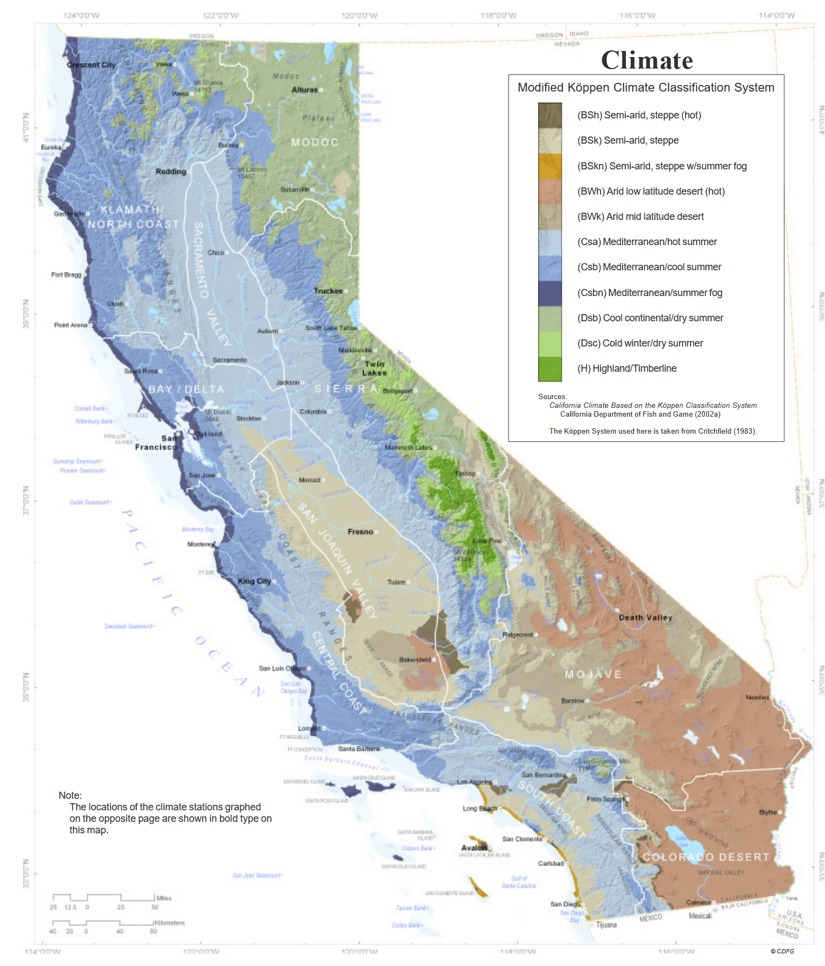
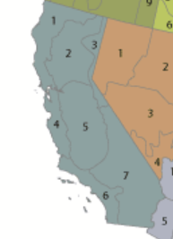
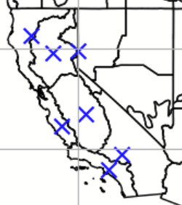
The DATA
1 | North Coast Drainage
2 | Sacramento Drainage
3 | Northeast Interior Basins
4 | Central Coast Drainage
5 | San Joaquin Drainage
6 | South Coast Drainage
7 | Southeast Desert Basin
*Shapely” to find one fire centroid per climate division.
*GEOPandas” to geo-locate labels and features to counties and climate divisions
Notes:
California averaged weather features organized as a time series.
Boolean label indicating if any fire start throughout the state was reported
“Slide 5 provides an overview of how we constructed and enhanced our dataset. We started with a time series of California-averaged weather features and a basic Boolean fire label, courtesy of the California Weather & Fire Prediction dataset from Zenodo. While academically useful, this initial data lacked the geospatial granularity necessary for real-world application.
To address that, we integrated geolocated CAL FIRE historical fire data—including the 2024 and 2025 datasets—and used GeoPandas to map each fire to its county and the appropriate CONUS Climate Division. We specifically chose these divisions because fires are heavily influenced by seasonal and localized weather patterns, and the divisions also help reduce the number of classes we need to predict. Next, we leveraged Shapely to identify the centroids of fires within each division and pulled localized weather data for those coordinates from NASA’s POWER website. In addition to pinpointing fire locations, we also incorporated a wide range of MERRA-2 weather variables, such as temperature (max, min, and range), humidity (relative and specific), precipitation, wind speed, and wind direction. These granular metrics help capture the environmental conditions that drive wildfire risks. We could easily spend over 12 minutes diving into the finer details of this process, but Slide 5 offers a high-level snapshot of how we evolved a simple time-series dataset into a richer, location-aware resource for wildfire forecasting.”

Slide 6
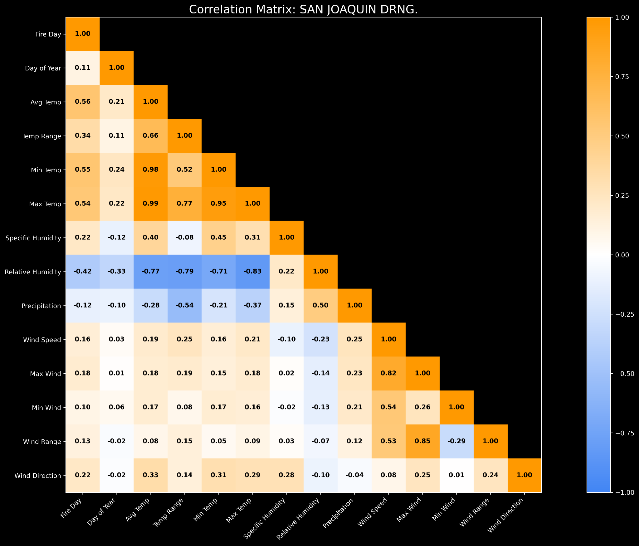
EDA - Feature correlation

Slide 7
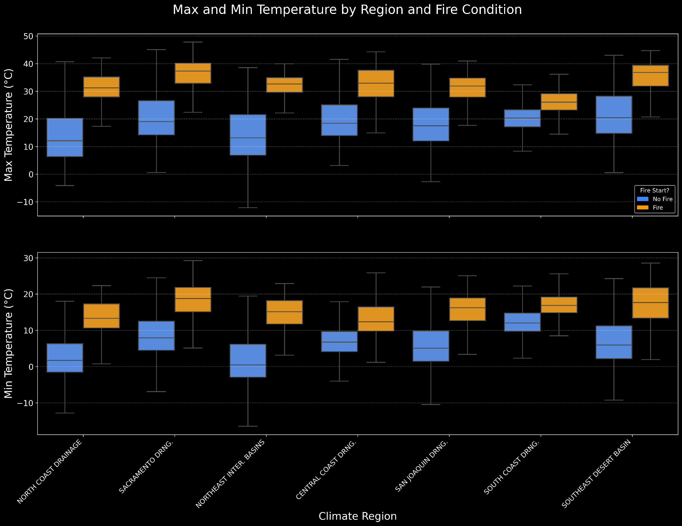
EDA - Temperature

Slide 8
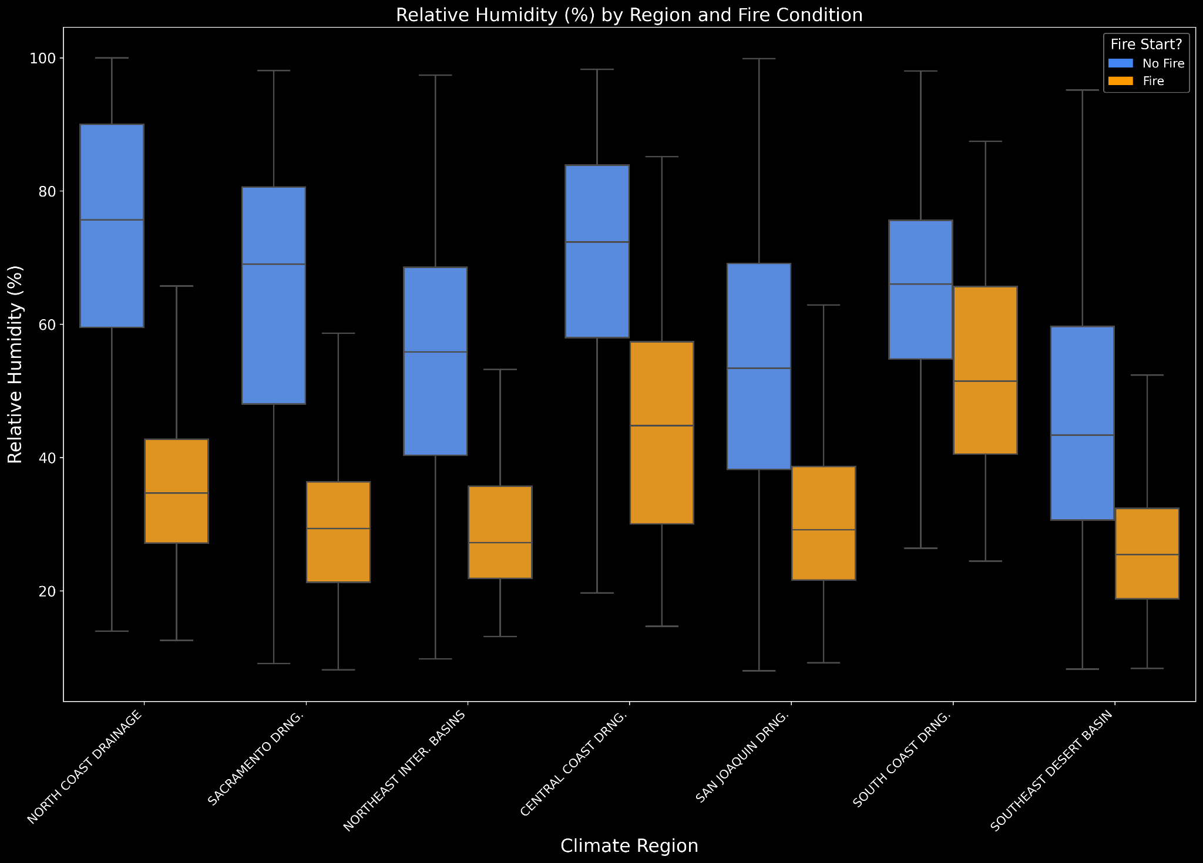
EDA - Relative Humidity

Slide 9
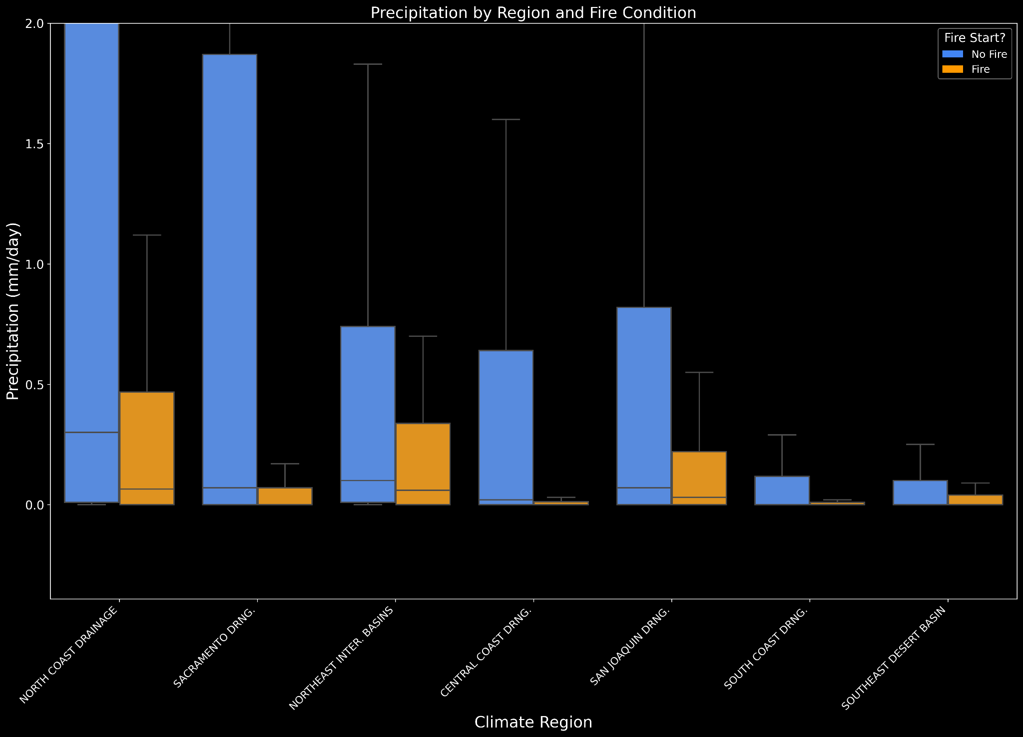
EDA - Precipitation

Slide 10
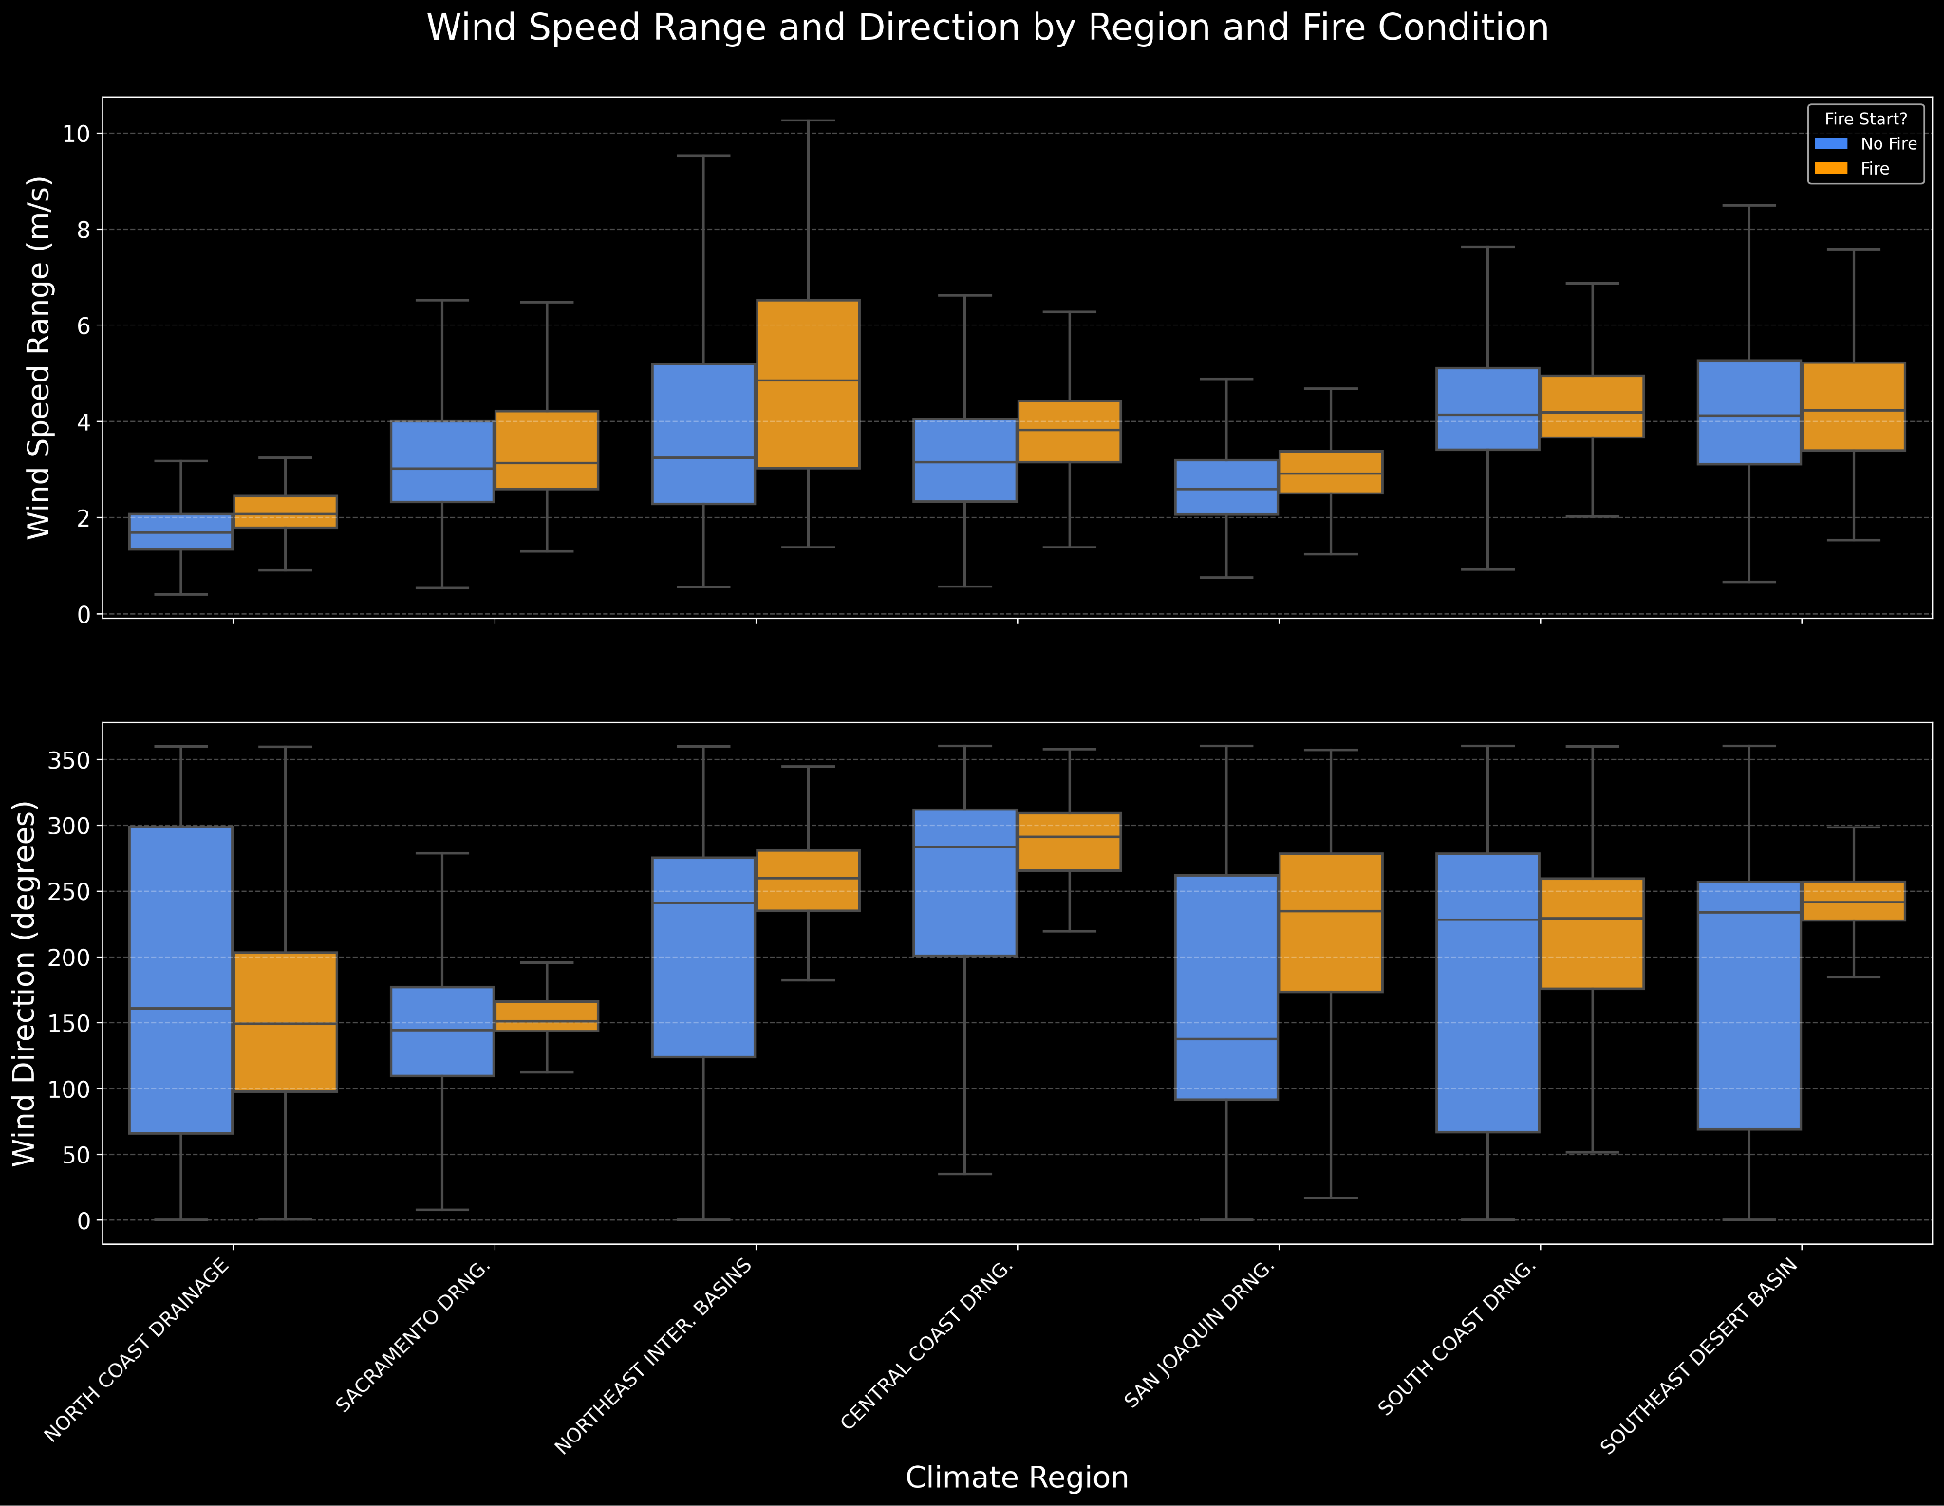
EDA - wind speed and direction

Slide 11
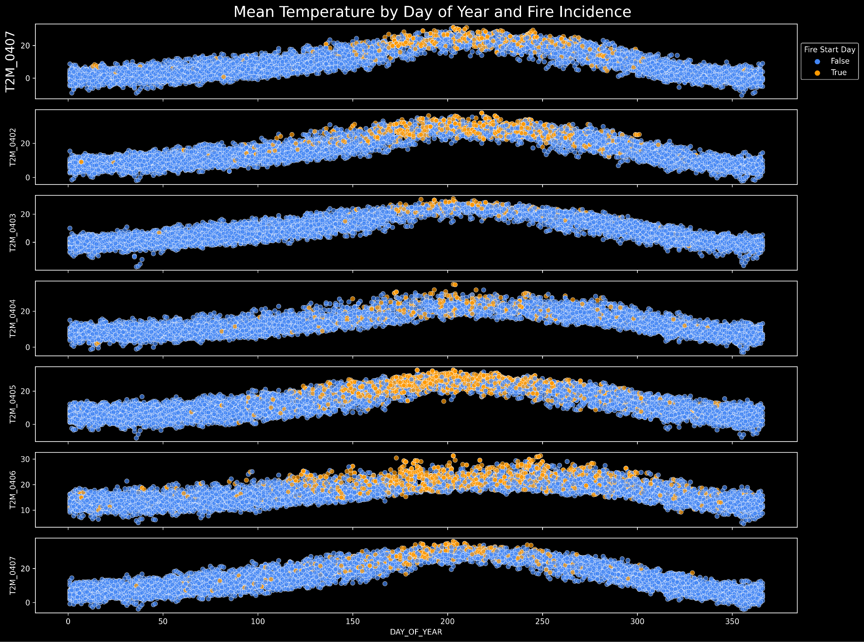
EDA - seasonality

Slide 12
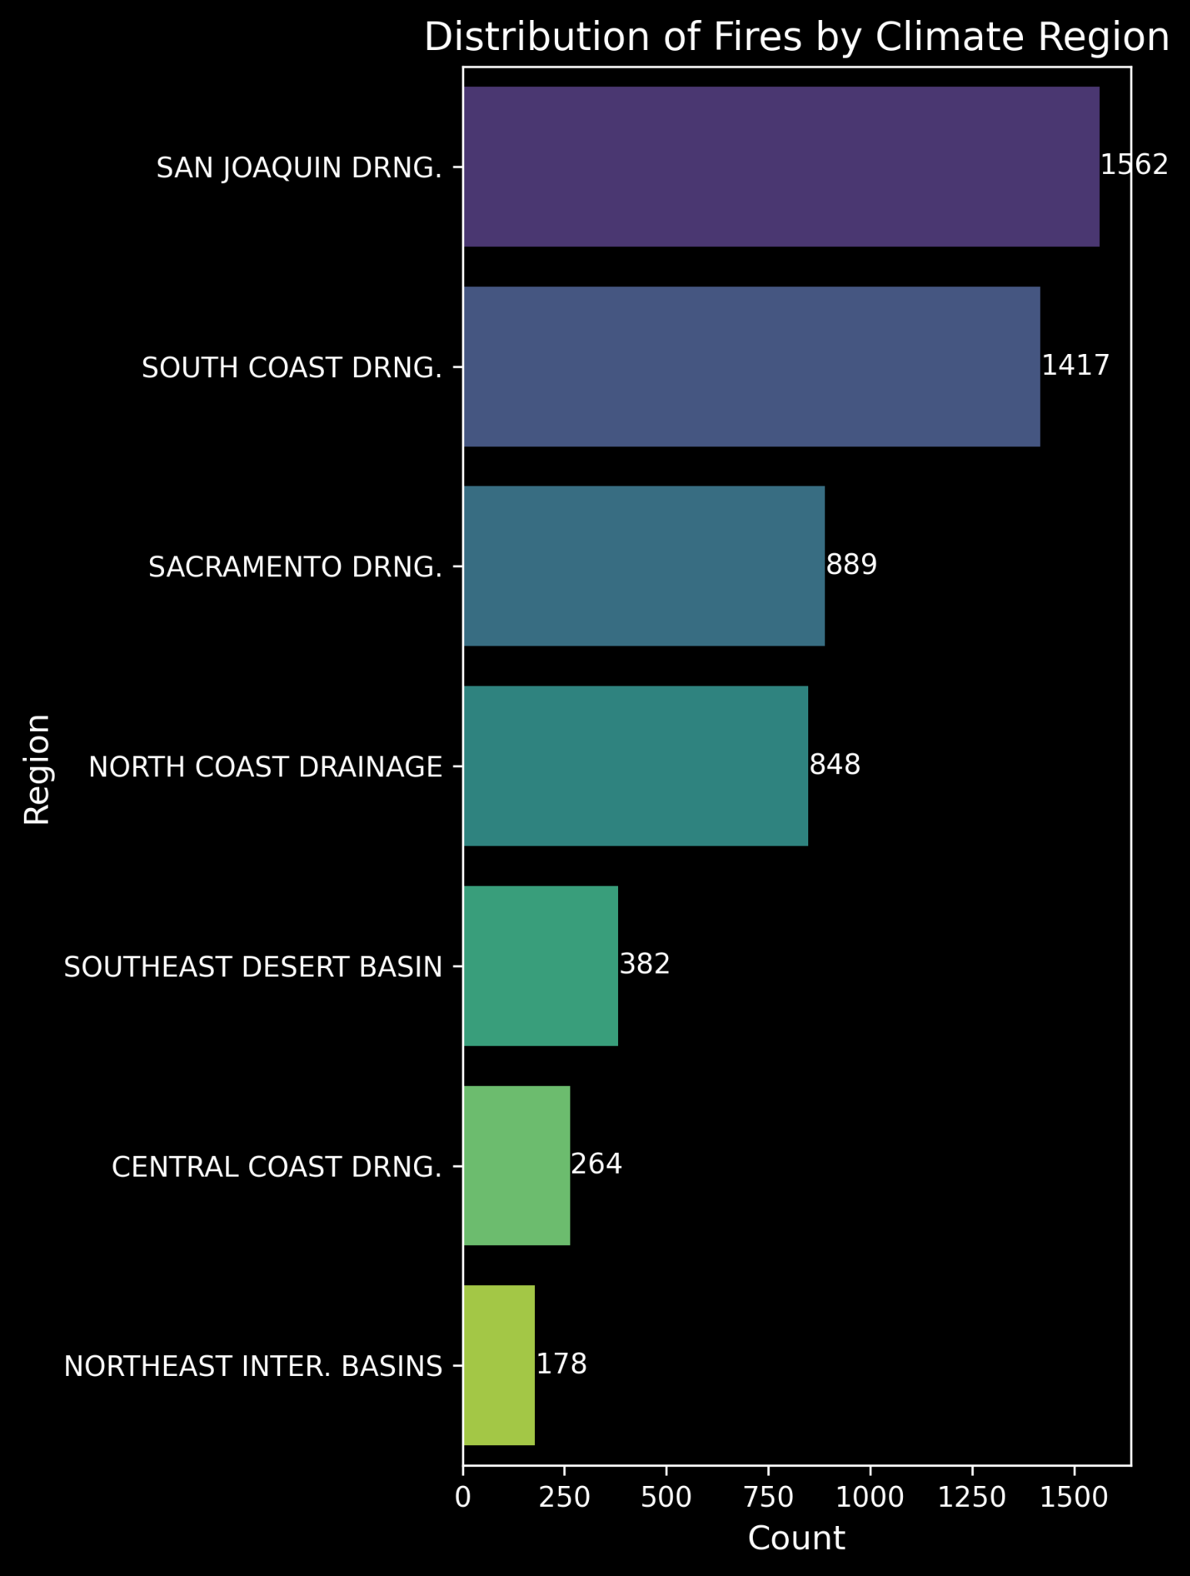
EDA - class imbalance
Slight imbalance in training dataset binary outcome (64% days without a fire), moderate risk of:
High accuracy but lower recall
overfitting
Fire prevalence varies widely by climate region
178 examples in Northeast Inter. Basins
1,562 examples in San Joaquin Drainage
Nearly 9-fold difference b/w smallest and largest classes

Slide 13

Experiment Summary: Baseline and Advanced
60%
20%
Item # | Purpose | ML Model | Test Evaluation Metric | % Improve Over Baseline | Features and Labels | Hyper Parameters
1 | Short-term wildfire outbreak prediction model for California (3, 7, and 14-day forecasts) Targets outbreak prediction at the CONUS climate division level within California | Baseline Logistic regression (SciKit Learn) | Accuracy Precision Recall F1 y_3 0.453 0.506 0.453 0.473 y_7 0.320 0.404 0.320 0.349 y_14 0.232 0.318 0.232 0.260 | Not Applicable | Labels: 3, 7, 14 days forecasts, CONUS climate divisions Features: Geolocated Fire and weather data | Algo: Multinomial Logistic Regression Regularization Strength: C=1.0 Solver: LBFGS Class Weighting: Balanced Max Iterations: 1000 Multi-class Strategy: Multinomial None tuned
2 | Short-term wildfire outbreak prediction model for California (3, 7, and 14-day forecasts) Targets outbreak prediction at the CONUS climate division level within California | Feedforward Neural Network with Tuned hyperparameter selections (Optuna) | Accuracy Precision Recall F1 y_3 0.508 0.531 0.508 0.517 y_7 0.367 0.417 0.367 0.381 y_14 0.257 0.328 0.257 0.275 | 3-day: 12.1% 7-day: 14.7% 14-day: 10.8% | Labels: 3, 7, 14 days forecasts, CONUS climate divisions Features: Geolocated Fire and weather data | n_layers, n_units, activation, dropout, learning_rate, batch_size, lr_decay_factor, lr_patience Tuned using Optuna
3 | Short-term wildfire outbreak prediction model for California (3, 7, and 14-day forecasts) Targets outbreak prediction at the CONUS climate division level within California | Random Forest Random Forest + PCA RF + SMOTE + PCA | Accuracy Precision Recall F1 y_3 0.533 0.470 0.422 0.438 Y_7 0.405 0.327 0.288 0.290 y_14 0.341 0.232 0.229 0.217 | 3-day: 8% 7-day: 8.5% 14-day: 10% | Labels: 3, 7, 14 days forecasts, CONUS climate divisions Features: Geolocated Fire and weather data | n_estimators,max_depth, min_samples_split, min_samples,max_features, class_weight, random_state, n_jobs
4 | Short-term wildfire outbreak prediction model for California (3, 7, and 14-day forecasts) Targets outbreak prediction at the CONUS climate division level within California | XGBoost with random search for hyperparameter tuning | Accuracy Precision Recall F1 y_3 0.542 0.525 0.542 0.525 y_7 0.406 0.393 0.406 0.369 y_14 0.338 0.347 0.338 0.284 | 3-day: 8.9% 7-day: 8.6% 14-day: 10.6% | Labels: 3, 7, 14 days forecasts, CONUS climate divisions Features: Geolocated Fire and weather data | n_estimators, max_depth, learning_rate, reg_alpha, reg_lambda, min_child_weight, gamma, subample, colsample_bytree
5 | Short-term wildfire outbreak prediction model for California (3, 7, and 14-day forecasts) Targets outbreak prediction at the CONUS climate division level within California | ARIMA (SARIMAX) | Accuracy Precision Recall F1 y_3 0.672 0.558 0.690 0.617 y_7 0.659 0.529 0.692 0.600 y_14 0.650 0508 0.695 0.587 | 3-day: 21.9% 7-day:33.9% 14-day: 41.8% | Labels: 3, 7, 14 days forecasts, CONUS climate divisions Features: Geolocated Fire and weather data | Order (p,d,q) Seasonal order (P, D, Q)
Notes:
We began with a straightforward logistic regression model as a baseline for comparison against more advanced approaches—including Neural Networks, Random forest , XGBOOST and ARIMA (SARIMAX). Among these, ARIMA (SARIMAX) emerged as the strongest performer, improving the 3-day forecast by 21.9%, the 7-day by 33.9%, and the 14-day by 41.8%. While even the simplest model beat random chance, the more sophisticated methods not only boost near-term accuracy but also sustain valuable predictive power over longer horizons, providing robust insights for resource allocation and strategic planning.”

Slide 14
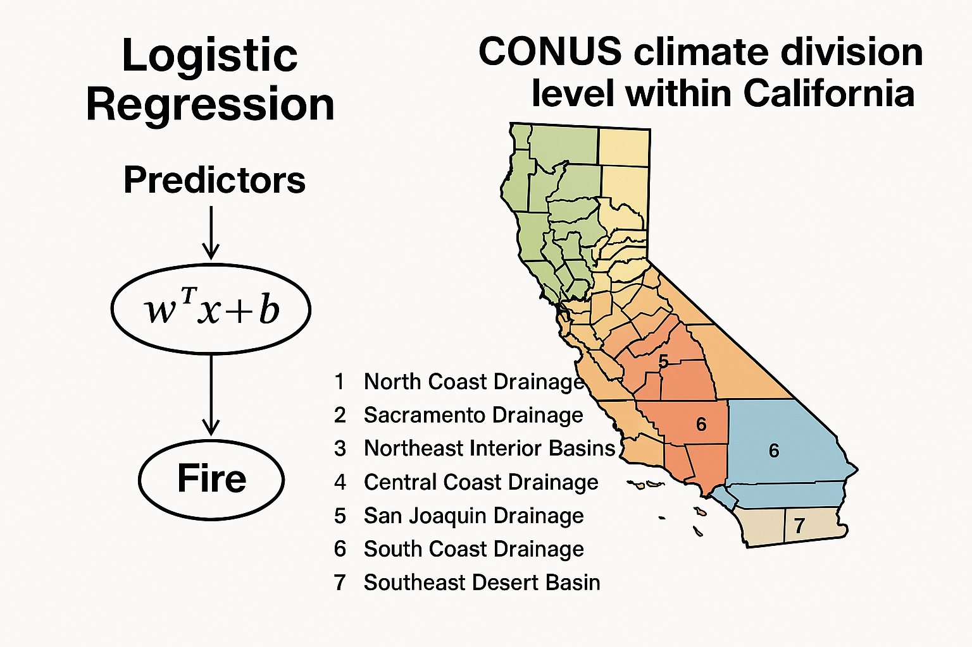
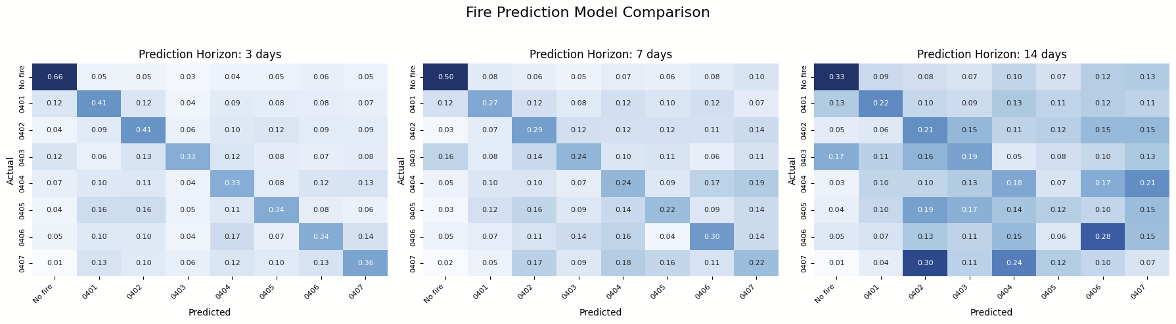
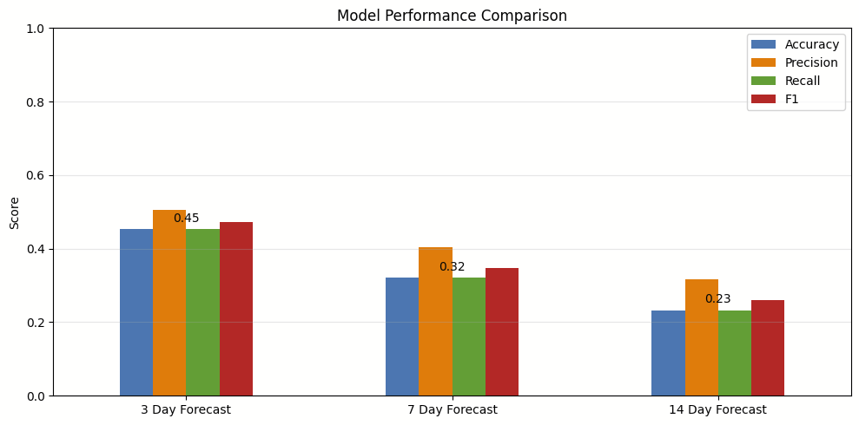
Logistic Regression (Baseline)
Scikit learn
Key Insights
Performance degrades with longer horizons, yet even 14-day predictions (23.2% accuracy) outperform random guessing by 85% in our 8-class problem, confirming genuine predictive power.
Higher precision than accuracy indicates the model selectively predicts fires, reducing false alarms while maintaining detection capability.
The model delivers strong short-term forecasting (3-day: 45.3% accuracy) while still providing actionable intelligence for longer horizons despite increasing uncertainty.
Hyperparameters
Algorithm: Multinomial Logistic Regression
Regularization Strength: C=1.0 (moderate)
Solver: LBFGS (quasi-Newton method)
Class Weighting: Balanced (inversely proportional to class frequencies)
Max Iterations: 1000
Multi-class Strategy: Multinomial (true softmax-based approach)
Performance Metrics
Accuracy Precision Recall F1
y_3 0.453 0.506 0.453 0.473
y_7 0.320 0.404 0.320 0.349
y_14 0.232 0.318 0.232 0.260
Notes:
“Slide 14 highlights our baseline model, a multinomial Logistic Regression. Although its accuracy decreases as we extend forecasts, it still beats random guessing by 85% even at the 14-day mark—showing genuine predictive power across all horizons. In the short term, it achieves a standout accuracy of 45.3% for the 3-day window, making it a reliable option for immediate decision-making. One notable finding is that the model’s precision often surpasses its accuracy, meaning it’s more selective in flagging fires and thus reduces false alarms. We chose moderate regularization (C=1.0), used an LBFGS solver, and set class weighting to ‘balanced’ to handle our eight labels fairly. While we ultimately rely on more advanced models, this logistic regression approach provides a solid yardstick against which we measure further improvements.”

Slide 15
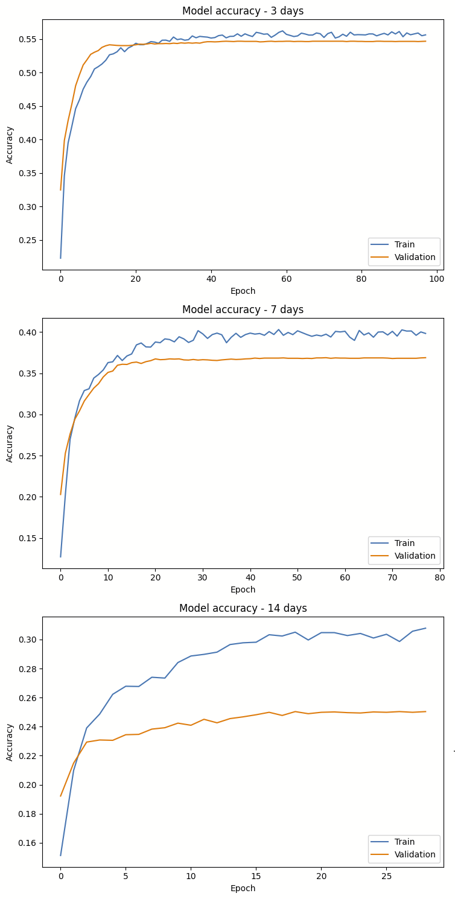
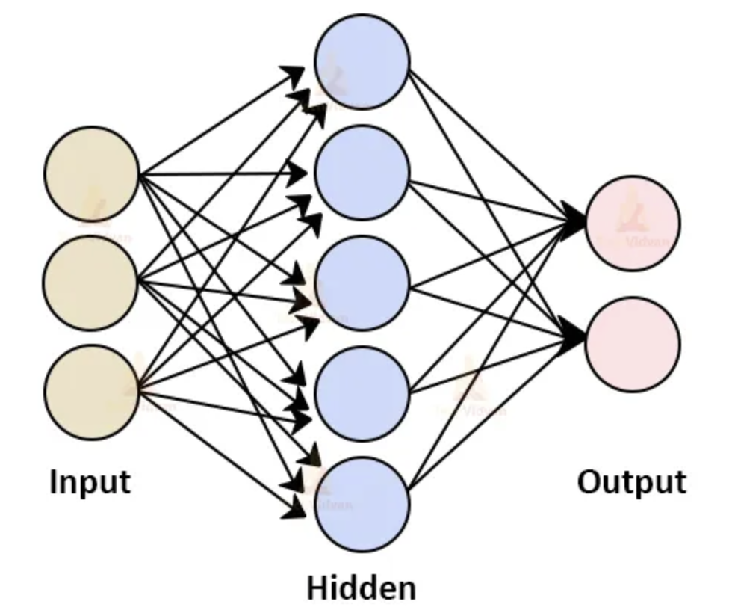
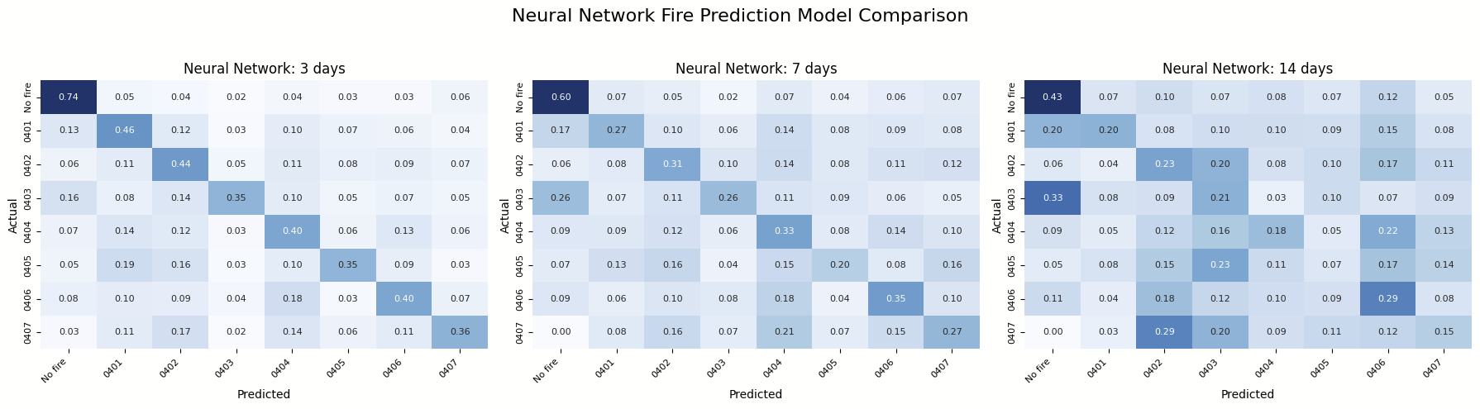
Neural Network
Best hyperparameters:
batch_size: 128
n_layers: 3
n_units_l0: 508
activation_l0: selu
dropout_l0: 0.49796887444551813
n_units_l1: 45
activation_l1: selu
dropout_l1: 0.003571962578178628
n_units_l2: 367
activation_l2: elu
dropout_l2: 0.1540127137562558
learning_rate: 1.3230185409824418e-05
lr_decay_factor: 0.49956238105043055
lr_patience: 3
Best validation accuracy: 0.5505
FF Neural Network vs. Baseline: Key Findings
FF Neural networks outperform logistic regression across all prediction horizons, with the most significant improvement in 3-day forecasts (+5.5 points, reaching 50.8% accuracy).
Performance degrades with longer horizons in both models, but neural networks degrade more gracefully, providing 10.8% better accuracy for 14-day predictions.
Improved precision (3-5%) indicates fewer false alarms, while enhanced recall means more actual fire events are correctly identified - critical for emergency response planning.
The optimized neural architecture successfully captures complex meteorological patterns that the simpler baseline model cannot detect.
Experiments:
Optuna for all hyperparameters
Weights for classes
Lagged features
Other architectures: CNN, LSTM
Accuracy Precision
y_3 0.508 0.531
y_7 0.367 0.417
y_14 0.257 0.328
Recall F1
y_3 0.508 0.517
y_7 0.367 0.381
y_14 0.257 0.275
Notes:
“Slide 15 showcases our shift to a feedforward neural network, outperforming the baseline logistic regression model across all forecast horizons. The most notable gain appears at the 3-day mark, where accuracy jumps by 5.5 points to 50.8%. Even at the 14-day horizon, this architecture maintains a 10.8% lead over the baseline. Higher precision (fewer false alarms) and better recall (more true fires caught) both support emergency response planning. While we experimented with other techniques—like class weighting, adding lagged features, and even CNN or LSTM architectures—the feedforward network, fine-tuned with Optuna for layers, activation functions, and dropout rates, delivered the strongest results. Overall, this model captures complex meteorological patterns that simpler approaches tend to overlook.”

Slide 16
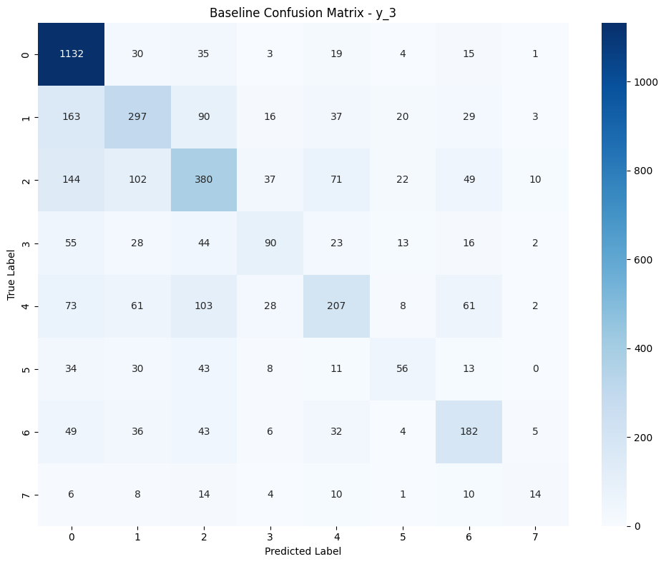
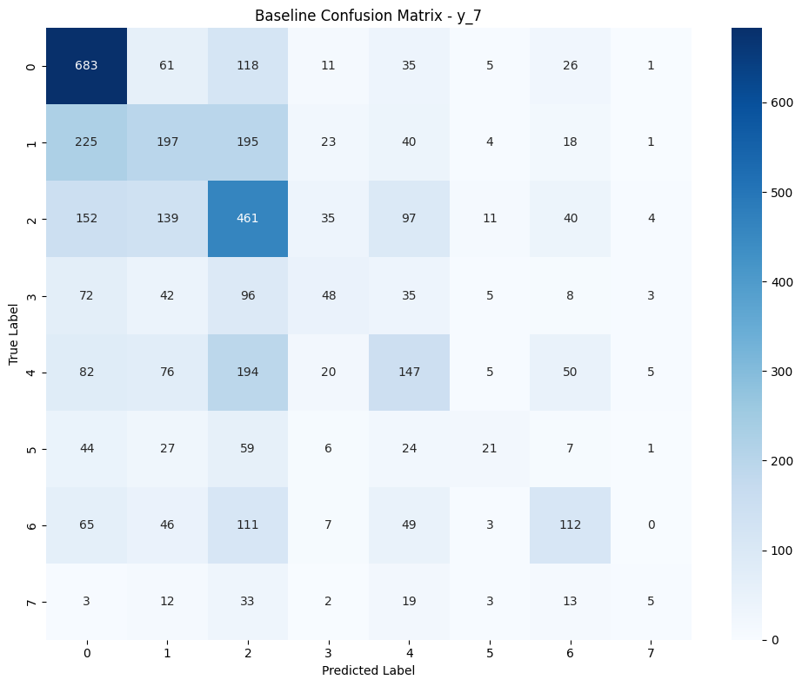
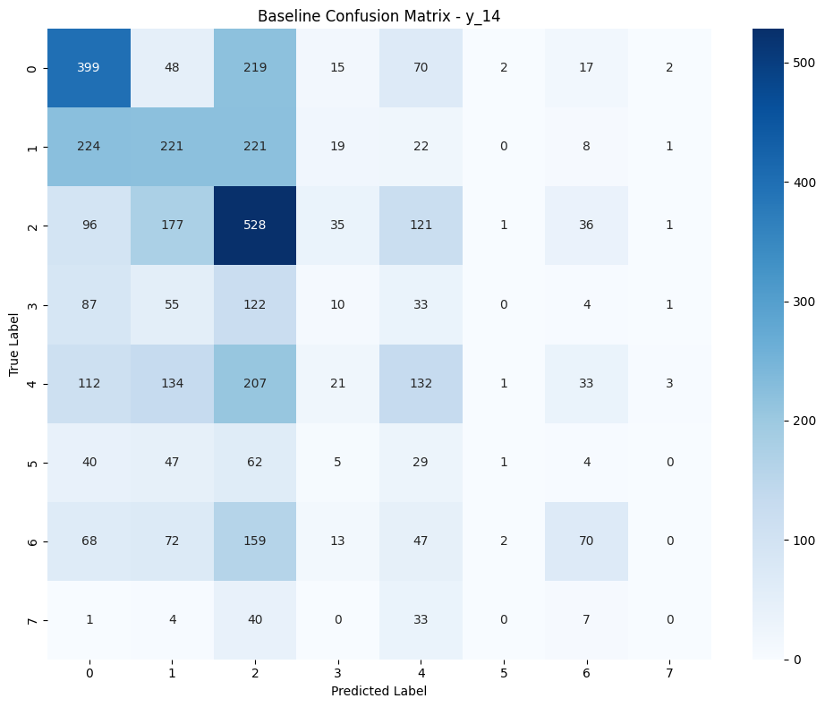
Random forest
Key Insights
10% increased accuracy over baseline logistic model for predicting that a fire starts within 3, 7, and 14 days.
Feature importance insights highlight temperature and humidity as key predictors
Handles non-linearity between fire occurrence and weather variables
Model Summary
Train Data: 12426 w/ 100+ features
Validation Data: 4142 w/ 100+ features
Test Data: 4142 w/ 100+ features
Hyperparameters
Algorithm: RandomForestClassifier
n_estimators: 100
max_depth: 20
random_state: 42
class_weight: 'balanced'
n_jobs: -1
Best tuned hyperparameters
Best Parameters
SMOTE sampling strategy: 'auto' (all classes balanced)
n_estimators: 100
max_depth: 20
Performance Metrics
Accuracy Precision Recall F1
y_3 0.533 0.470 0.422 0.438
y_7 0.405 0.327 0.288 0.290
y_14 0.341 0.232 0.229 0.217
Notes:
For our next model, we implemented a Random Forest Classifier. We chose Random Forest because it is effective at handling non-linear relationships between weather variables like temperature, humidity, and wind.

Slide 17
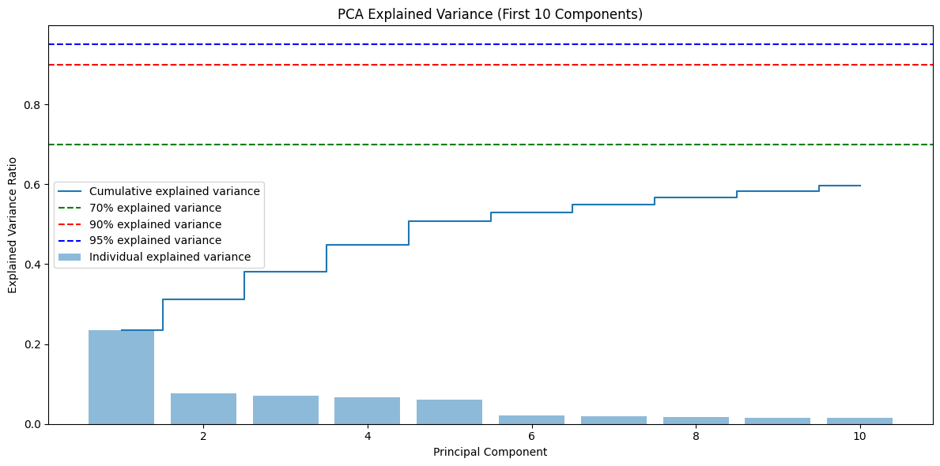
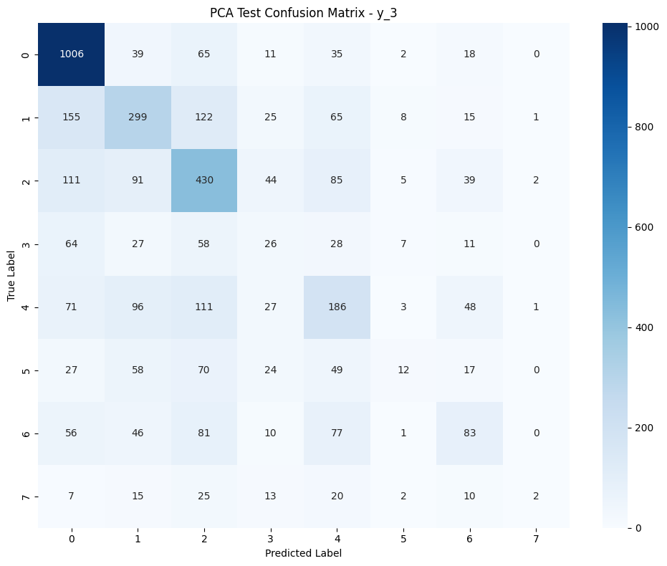
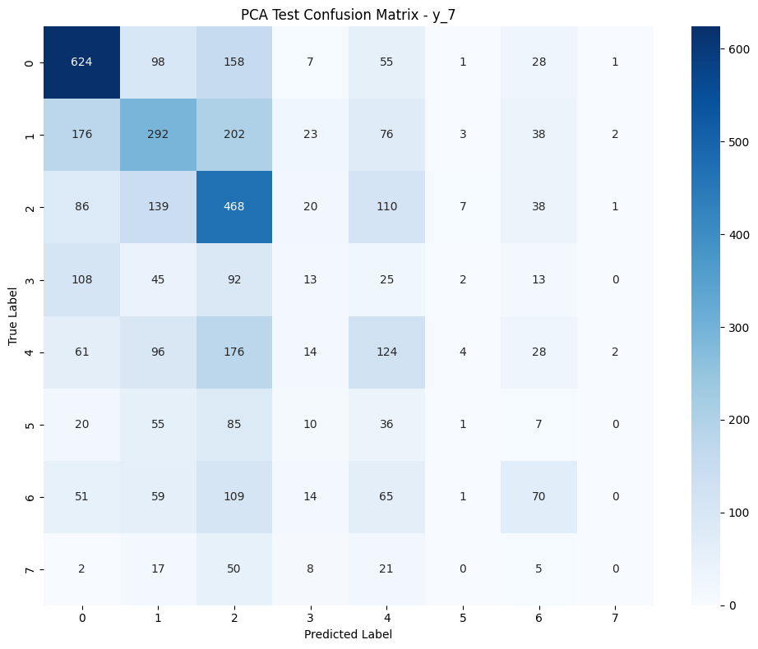
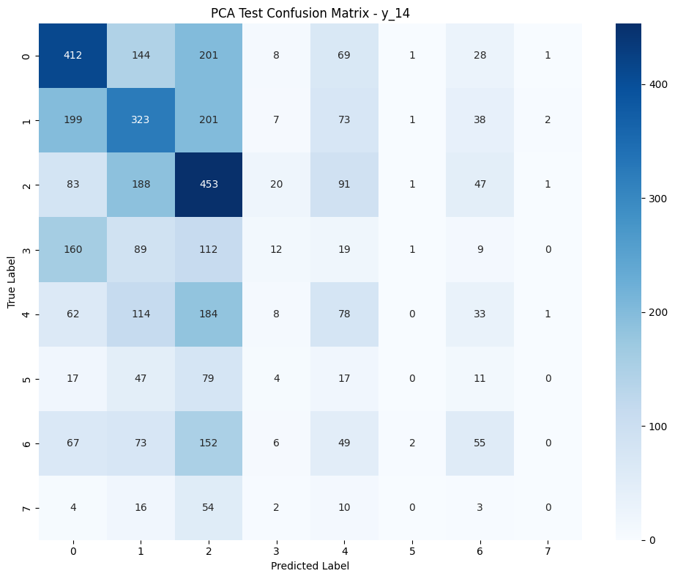
Random forest + PCA
Key Insights
Performed slightly worse than baseline RF
Could be due to class imbalance and overfitting
Applying sampling techniques such as SMOTE (Synthetic Minority Over-sampling Technique) could help
Hyperparameters
Algorithm: RandomForestClassifier + PCA
n_components: 10 for PCA
n_estimators: 300
max_depth: 50
random_state: 42
min_samples_split: 2
min_samples_leaf: 1
max_features: 'sqrt'
class_weight: 'balanced'
n_jobs: -1
Performance Metrics
Accuracy Precision Recall F1
y_3 0.494 0.367 0.319 0.313
y_7 0.387 0.246 0.251 0.238
y_14 0.324 0.211 0.215 0.200
Notes:
Next, we experimented with dimensionality reduction using PCA combined with Random Forest. The motivation here was to reduce overfitting and improve generalization by simplifying the feature space.

Slide 18
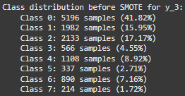
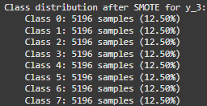
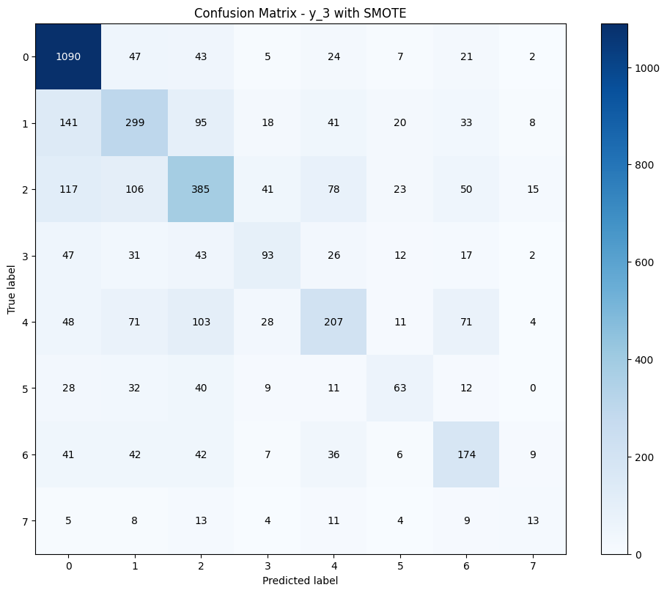
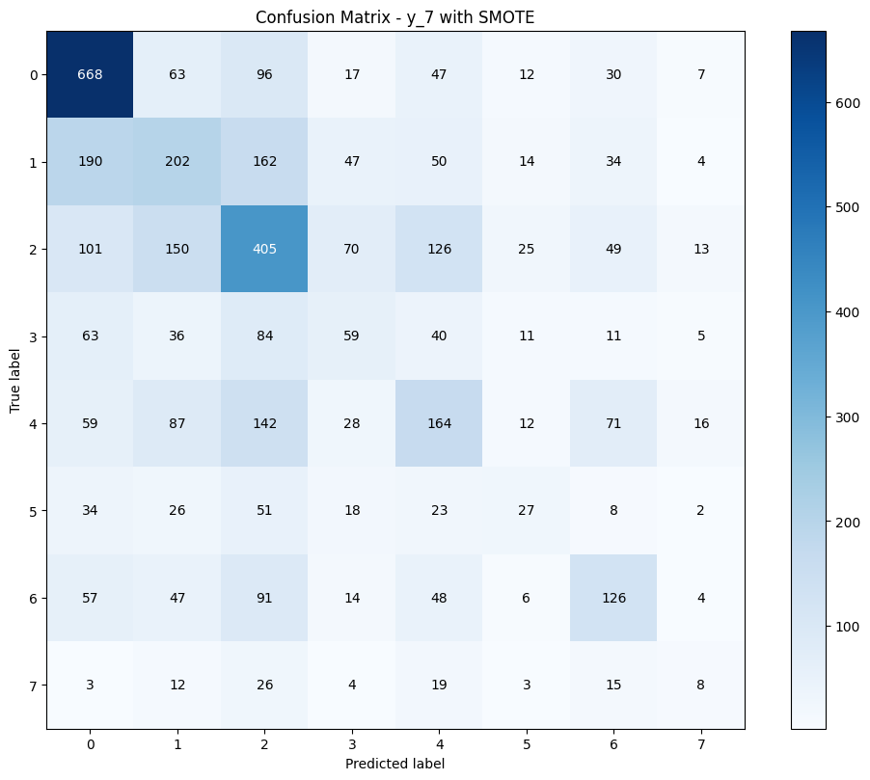
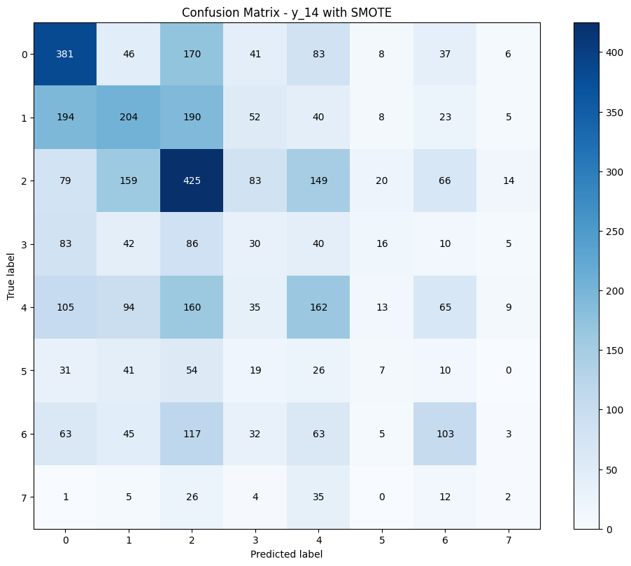
Random forest + SMOTE
Key Insights
Balanced dataset by creating synthetic examples for minority classes
Improved recall for fire detection by over 23%
Although accuracy is slightly less than baseline RF, improved overall in F1 score and Recall
Hyperparameters
Algorithm: RandomForestClassifier + SMOTE
SMOTE sampling strategy: 'auto' (all classes balanced)
n_estimators: 100
max_depth: 20
Random state: 42 (for reproducibility)
n_jobs: -1
Performance Metrics
Accuracy Precision Recall F1
y_3 0.527 0.437 0.417 0.424
y_7 0.395 0.308 0.297 0.299
y_14 0.317 0.232 0.228 0.225
Notes:
To counter the class imbalance more directly, we applied SMOTE (Synthetic Minority Over-sampling Technique) before training the Random Forest.

Slide 19
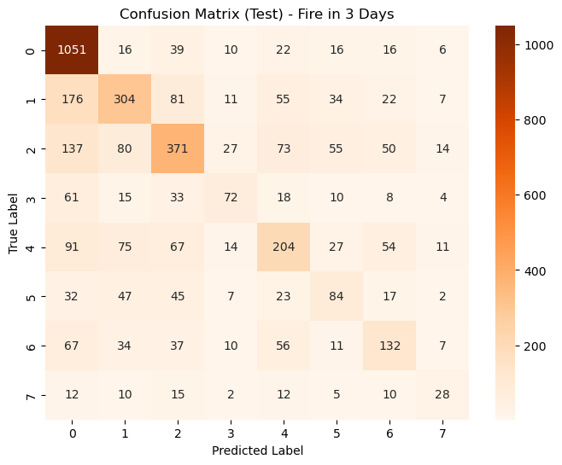
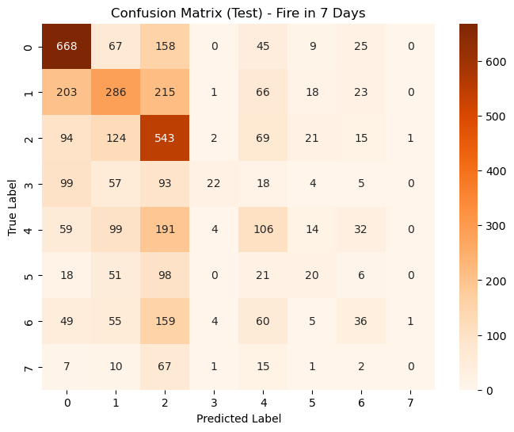
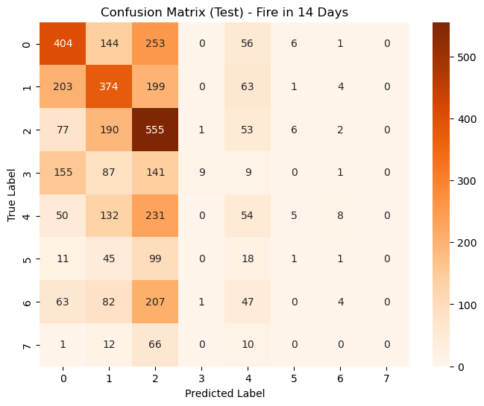
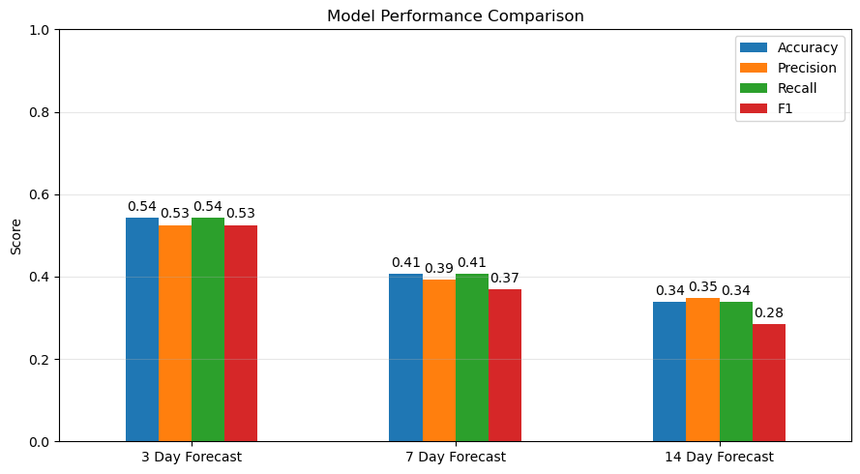
Xgboost
Key Insights
All XGBoost models outperform baseline, demonstrating strong pattern recognition at short and long horizons
The 3-day model reaches 54.2% accuracy, indicating high short-term predictive power
The 7-day and 14-day models show diminishing performance, reflecting the growing challenge of forecasting fire risk further into the future
Precision remains relatively stable across time windows, showing the model remains cautious and consistent in identifying true fire risks
Performance Metrics
Accuracy Precision Recall F1
y_3 0.542 0.525 0.542 0.525
y_7 0.406 0.393 0.406 0.369
y_14 0.338 0.347 0.338 0.284
Hyperparameter Tuning
Random search with 20 iterations per model (best parameters listed below)
 | n_estimators | max_depth | learning_rate | reg_alpha | reg_lambda | min_child_weight | gamma | subsample | colsample_bytree
3 Day | 250 | 1 | 0.02 | 0.3 | 2.0 | 1.0 | 0.4 | 1.0 | 1.0
7 Day | 200 | 5 | 0.04 | 0.3 | 1.0 | 5 | 0 | 0.8 | 0.3
14 Day | 300 | 3 | 0.03 | 0.8 | 0.5 | 3 | 0.3 | 1.0 | 0.3
Notes:
The next model we used the XGBoost algorithm which a powerful gradient boosting technique that's very useful for time series data.
XGBoost performed best for predicting fires in the next 3 days, with an accuracy of 54.2%, and a balanced precision and recall. The 7-day model dropped in performance, with an accuracy of 40.6%. Finally, the 14-day model had the lowest metrics across the board, with accuracy at 33.8%, showing that predictive power decreases as the time window extends.
These results suggest short-term predictions are more reliable, and that fire risk patterns may be more harder to capture further out in time over a loner horizon.
To identify the best-performing XGBoost models for predicting fires in 3, 7, and 14 days, we ran random search with 20 iterations per model. This allowed us to explore combinations across nine key hyperparameters, including tree depth, learning rate, and regularization settings.
Overall, there's no single trend across the time windows, but this reflects how model complexity and constraints must adapt to the unique signal and noise characteristics at different time horizons.

Slide 20

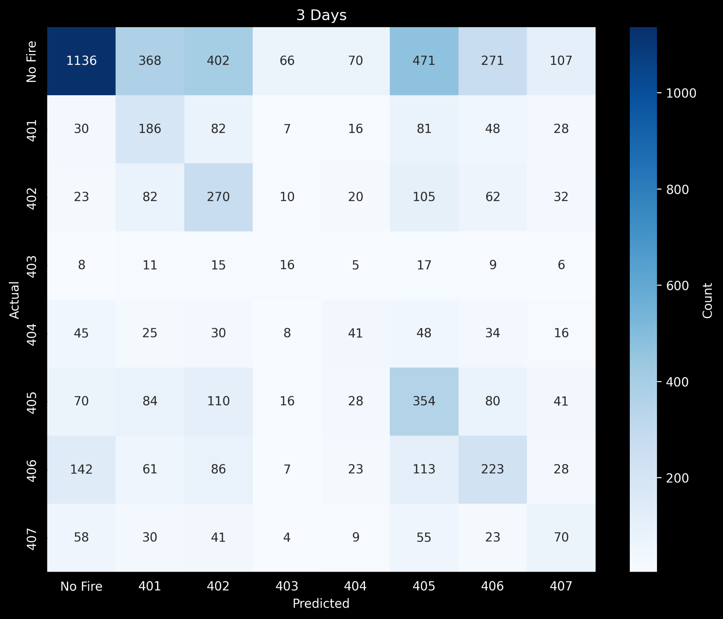
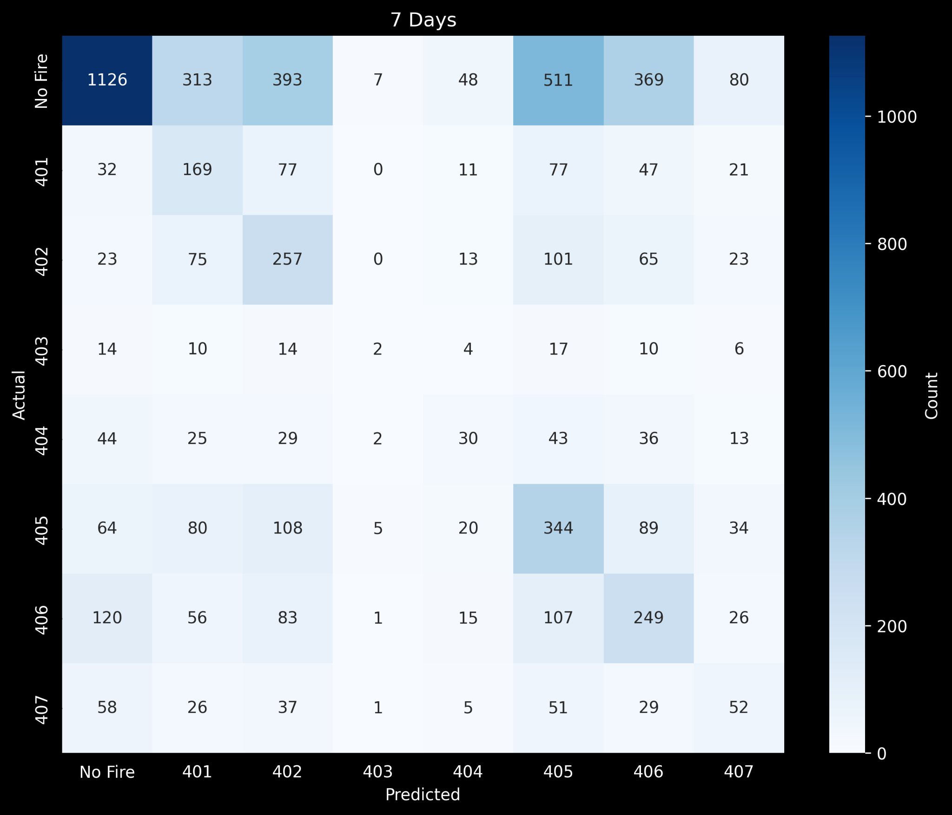

Arima/SARIMAX
Hyperparameters
Used auto ARIMA to iterate and determine optimal ordering values described below
ARIMA order:
p: number of autoregressive (AR) terms
d: number of differencing terms
q: number of moving average (MA) terms
Seasonal order:
P: seasonal AR
D: seasonal differencing
Q: seasonal MA
s: season step size
Insights
ARIMA excels in seasonal forecasting with suspiciously little degradation in accuracy
More time needed to investigate with other time-series models like Prophet
Longer time periods needed to observe when dropoff in accuracy occurs
Accuracy Precision Recall F1 y_3 0.672 0.558 0.690 0.617 y_7 0.659 0.529 0.692 0.600 y_14 0.650 0.508 0.695 0.587

Slide 21
Conclusion
Even when compared to a baseline random assignment probability of 12.5% across eight labels, the models delivers strong short-term forecasting (3-day), while still providing actionable intelligence for longer horizons despite increasing uncertainty.
Model performance was impacted by class imbalance → majority of records indicated no fire occurrence
Short-term predictions (3-day horizon) consistently achieved higher accuracy than longer-term forecasts (7- and 14-day), highlighting the increasing difficulty of capturing fire risk patterns over time
ARIMA model yielded the best overall performance
A key limitation of the dataset is the scarcity of positive fire cases, underscoring a broader challenge in wildfire research: the need for more comprehensive and balanced fire incident data to improve model training
Future work will focus on exploring additional time series models, such as LSTM networks and seasonal statistical approaches, to better capture temporal dependencies and seasonal fire trends
Notes:
In conclusion, our results showed the ability for models to deliver strong short-term forecasting of fires within 3 days, and we were able to provide helpful intelligence for predicting over longer horizons. We also discovered the challenges of forecasting wildfire risk in general, especially in the face of significant class imbalance—where most observations indicated no fire. While short-term predictions proved more reliable, performance declined as the forecast window extended. Among the models evaluated, ARIMA delivered the strongest results. Importantly, the scarcity of positive fire cases in our data reflects a broader gap in wildfire research: the need for richer, more balanced datasets. As a next step, we aim to explore advanced time series models like LSTM networks and seasonal approaches to improve long-term predictive accuracy.

Slide 22
References
Original Dataset: Yavas, C. E., Kadlec, C., kim, J., & Chen, L. (2025). California Weather and Fire Prediction Dataset (1984–2025) with Engineered Features [Data set]. Zenodo. https://doi.org/10.5281/zenodo.14712845
Cal Fire Historical fire perimeters (1984 - 2023): https://gis.data.ca.gov/datasets/CALFIRE-Forestry::california-fire-perimeters-all/explore?location=37.251628%2C-119.269051%2C5.96
Cal Fire Historical fire perimeters (2024-2025): https://lab.data.ca.gov/dataset/ca-perimeters-cal-fire-nifc-firis-public-view downloaded from https://gis.data.cnra.ca.gov/api/download/v1/items/025fb2ea05f14890b2b11573341b5b18/geojson?layers=0
CONUS Climate divisions https://www.ncei.noaa.gov/access/monitoring/dyk/us-climate-divisions
CONUS Climate divisions boundaries https://psl.noaa.gov/data/usclimdivs/boundaries.html
NASA POWER Meteorology https://power.larc.nasa.gov/docs/methodology/meteorology/
Ritter, J., Young, M., & Krishnan, P. (2022, August 4).

Slide 23
THANKS!

